Slide 1

Slide 1
Tuning a database for millions of users
Chaowlert Chaisrichalermpol

Slide 2

Slide 10
Chaowlert Chaisrichalermpol
Senior Solution Architect at IBM

Slide 3



Slide 5
AGENDA
Design
Develop
Monitoring

Slide 4



Set your expectation
DBA
Developer
Today Topics

Slide 5
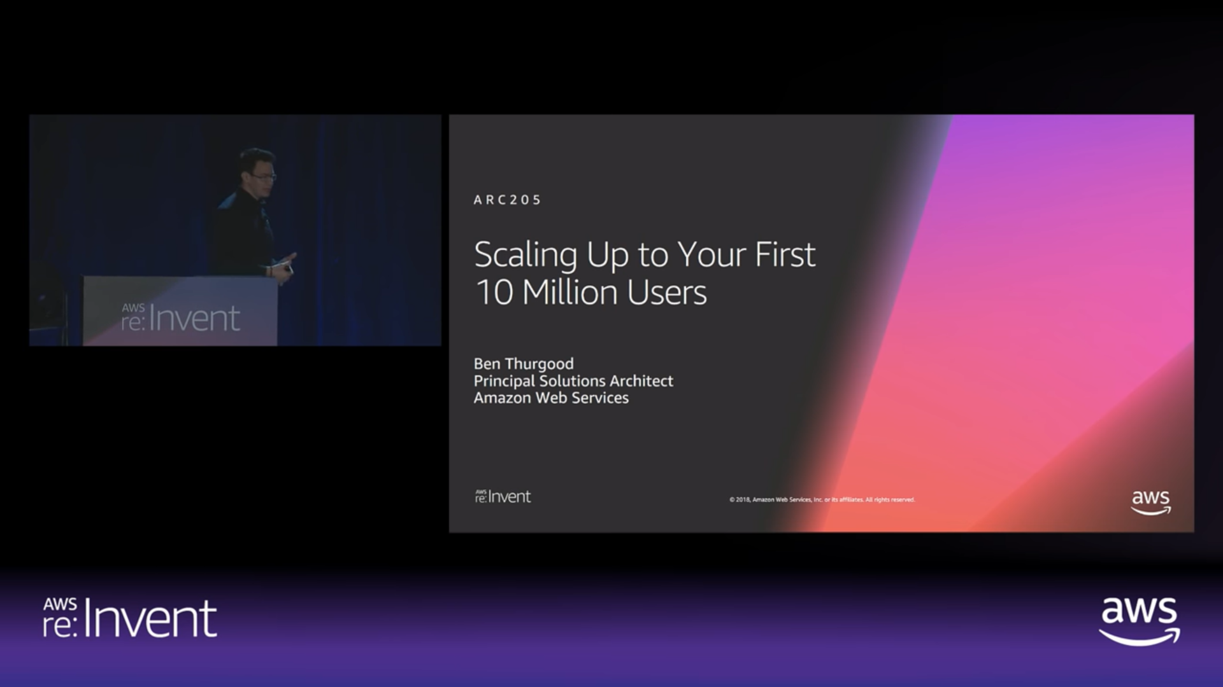
Scaling up to your first 10 million users
https://www.youtube.com/watch?v=Ma3xWDXTxRg

Slide 6
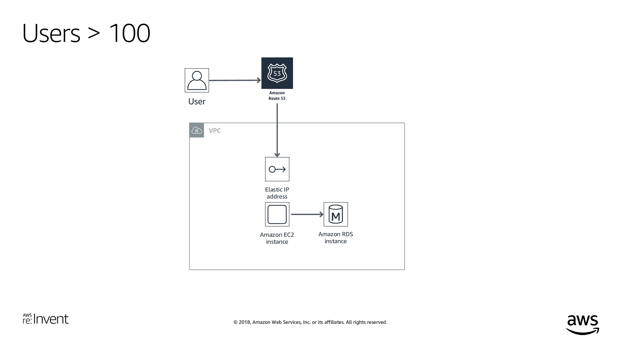

Slide 7
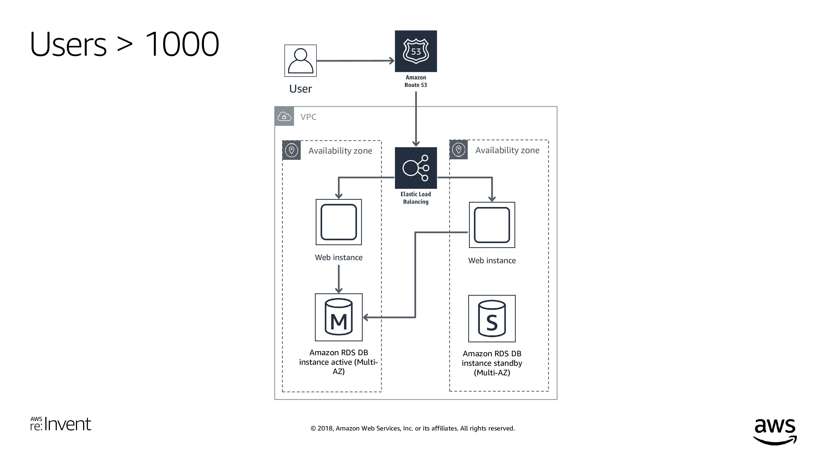

Slide 8
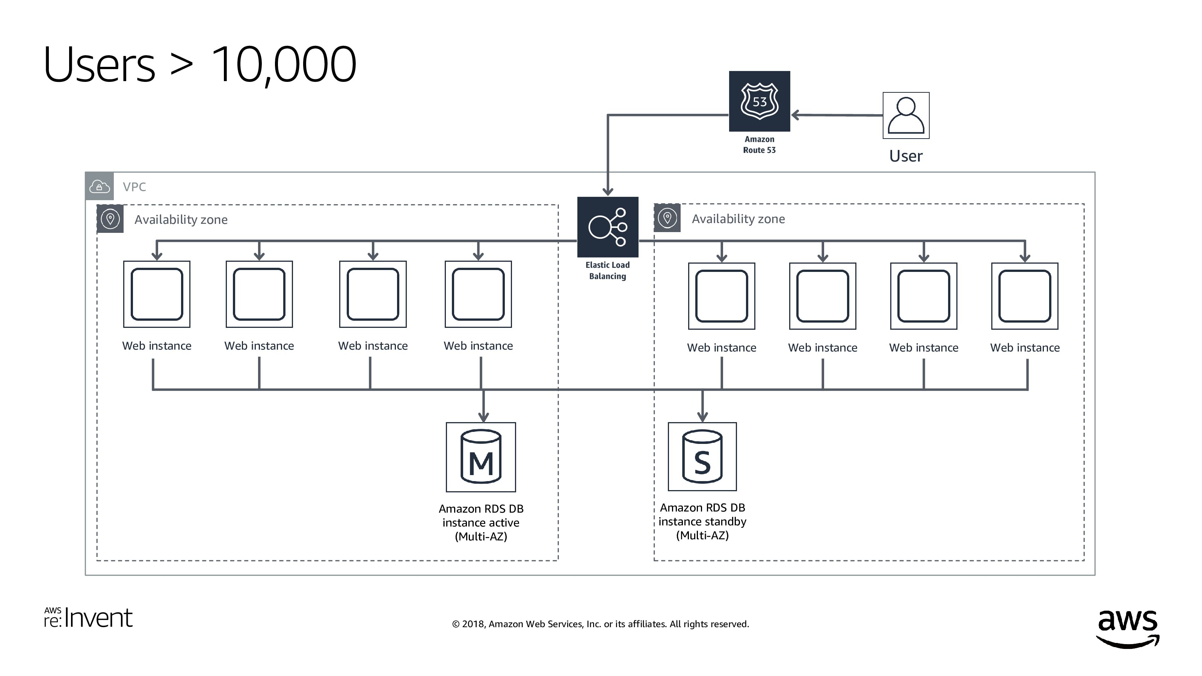

Slide 9
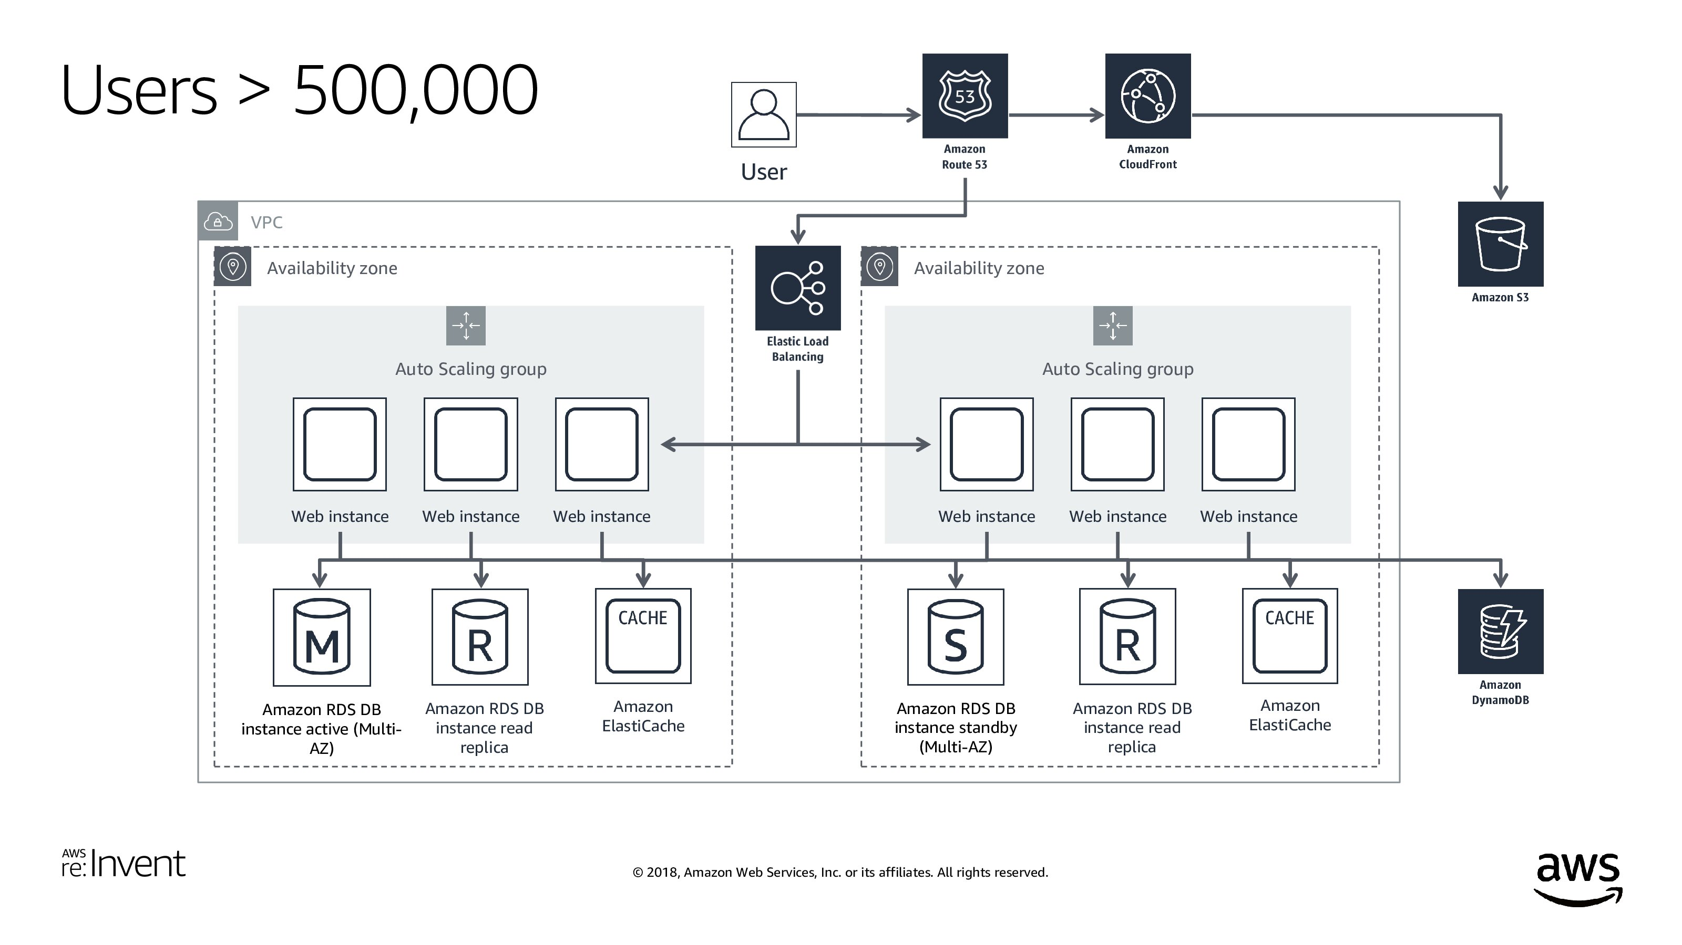

Slide 10
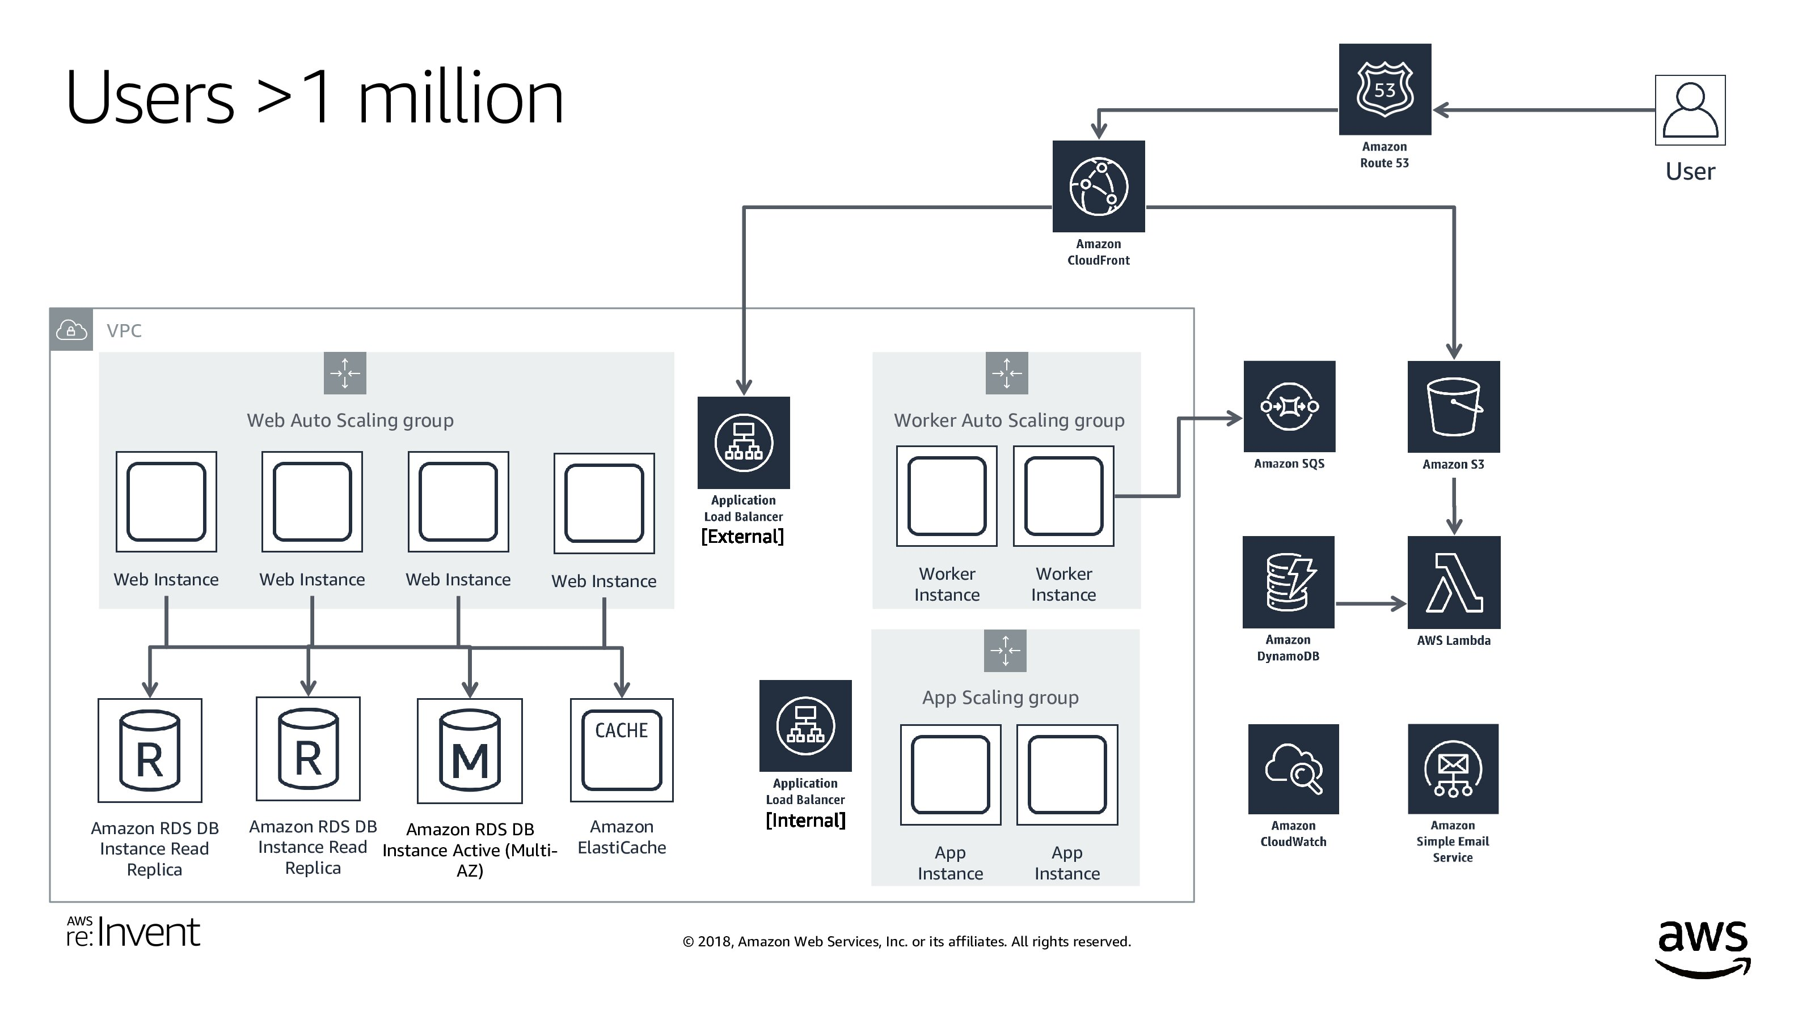

Slide 11
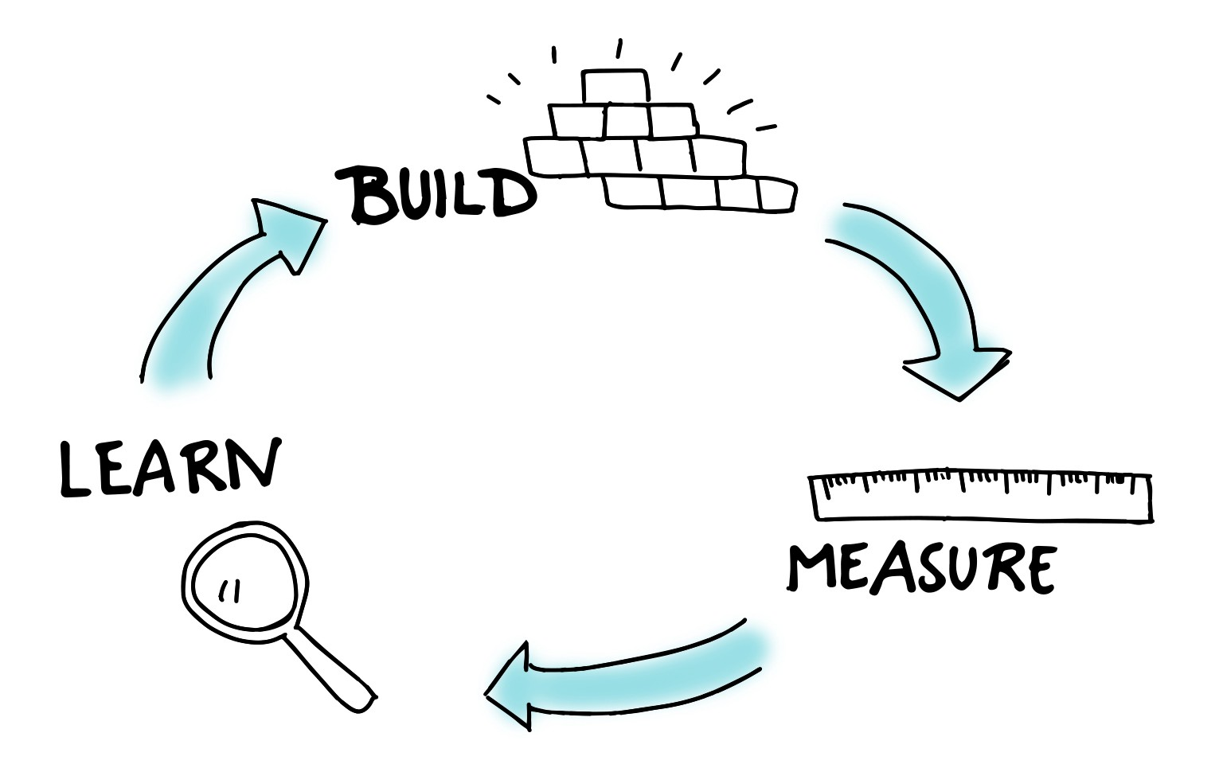
Why not we start with full architecture?

Slide 12
Should I use NoSQL?
If you plan for 500,000 users in first year
Lower cost storage, with no ACID features required (ex. Logs)

Slide 13
Should I start with Microservices?
Monolith first if
Bounded Context is still unclear
No time for Microservices complexity
No time for tooling

Slide 14
Understand Db Strength & Weakness
Strength
Established technology
ACID out of the box
Integrated metrics
Able to tune without effecting system
Weakness
Db always be bottleneck

Slide 15
Scaling Db
> 100 users
Scaling up
> 500,000 users
Move some functionalities to NoSQL
Caching
Move expensive queries to read replica
> 1,000,000 users
Async integration
Apply microservices and split databases
Db Partitioning

Slide 16
Slide 5
AGENDA
Design
Develop
Monitoring

Slide 17
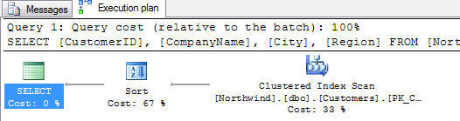
It’s all about Execution Plan
If you are Db Admin, let developers see Execution Plan

Slide 18
Workshop 1 - Index
https://data.stackexchange.com/stackoverflow/query/2469/all-my-badges
Table scan & index scan means db will search entire table
Foreign key is good candidate for index

Slide 19
Workshop 2 – Include columns
https://data.stackexchange.com/stackoverflow/query/7521/how-unsung-am-i
Key lookup means index need data from main table
You can add columns to index with include to reduce key lookup

Slide 20
Workshop 3 – Composite index
https://data.stackexchange.com/stackoverflow/query/947/my-comment-score-distribution
Sort is a good candidate for index

Slide 21
Workshop 4 – Merge duplicate index
https://data.stackexchange.com/stackoverflow/query/3160/jon-skeet-comparison
Index on columns A,B,C
Can be merged with A,B
Cannot be merged with A,C*
Cannot be merged with B,C*
* You might need to review index column sequence

Slide 22
Index basic
Lookup time much faster (n vs log(n))
Increase storage & modification time
Recommended number of indexes are 10 for read intensive, and 5 for write intensive (http://www.youtube.com/watch?v=gOsflkQkHjg)

Slide 23
Index usage
Avoid type conversion in where clause
Avoid using function on indexed column
Avoid OR
Index column sequence should match by equality first, then range lookup

Slide 24
Workshop 5 – CTE
https://data.stackexchange.com/stackoverflow/query/466/most-controversial-posts-on-the-site
Table variable is for a few rows
Use CTE if table is consumed only once
Notes:
create unique clustered index CL_PostId ON dbo.VoteStats (PostId)

Slide 25
How to handle complex queries?
Synchronous
Materialized view
New table
Use trigger to update
Update to new table in the same transaction
Asynchronous
Cache
Async integration
Async stream
Consistency
Latency

Slide 26
Slide 5
AGENDA
Design
Develop
Monitoring

Slide 27
Monitor your indexes
Missing indexes
Unused indexes
Merge duplicate indexes

Slide 28
Avoid local maxima
Tuning db
Tuning app

Slide 29
Query statistics
High worker time
High logical read
High total rows
High elapsed time
These are good candidates for precompute or caching
Notes:
MON_GET_PKG_CACHE_STMT
sys.dm_exec_query_stats
V$SQLSTATS
select t.text, r.* from sys.dm_exec_query_stats r
CROSS APPLY sys.dm_exec_sql_text(r.sql_handle) AS t
order by total_worker_time desc

Slide 30
Still local maxima?
Tuning db
Tuning app
Tuning infra
Tuning biz

Slide 31

Slide 11
Q & A

Slide 32

Send you CV & position to
chaowlert@th.ibm.com

Slide 33
Slide 11
THANK YOU

